Slide 1

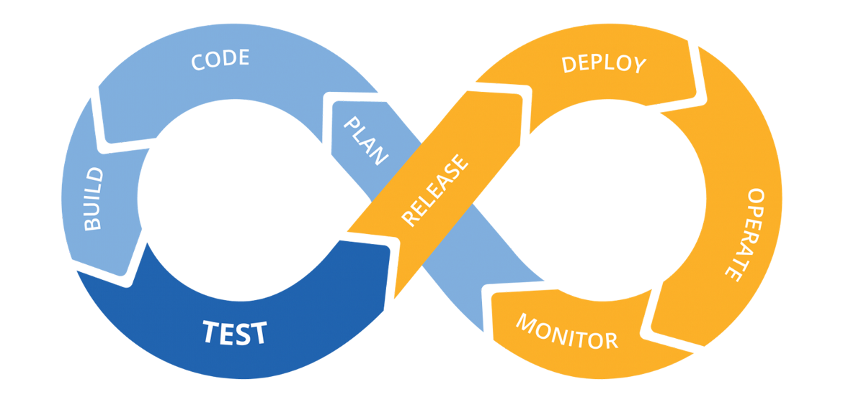

TIC4302 Group Project
Done by: Lam Yong Xian, Faiz Rashid and Eric Tong

Slide 2
Content
Application
Description
Brief Demo
Technology Stack
CI/CD Pipeline
Overview
Unit Test – Output & Fix
Secret Scan – Output & Fix
Software Composition Analysis – Output & Fix
Static Application Security Testing – Output & Fix
Image scan – Output & Post Fix
Dynamic Application Security Testing – Output, Fix and Acceptance
Problem faced (Broken pipeline)
Build
SAST
Functional Test
DAST

Slide 3
Application – Description
Simple Content Management System (CMS)
A web application that have login functionality and simple role-based access control capabilities (roles such as admin and editor).
It allows user to view, create, edit and delete posts that have file upload capability.

Slide 4
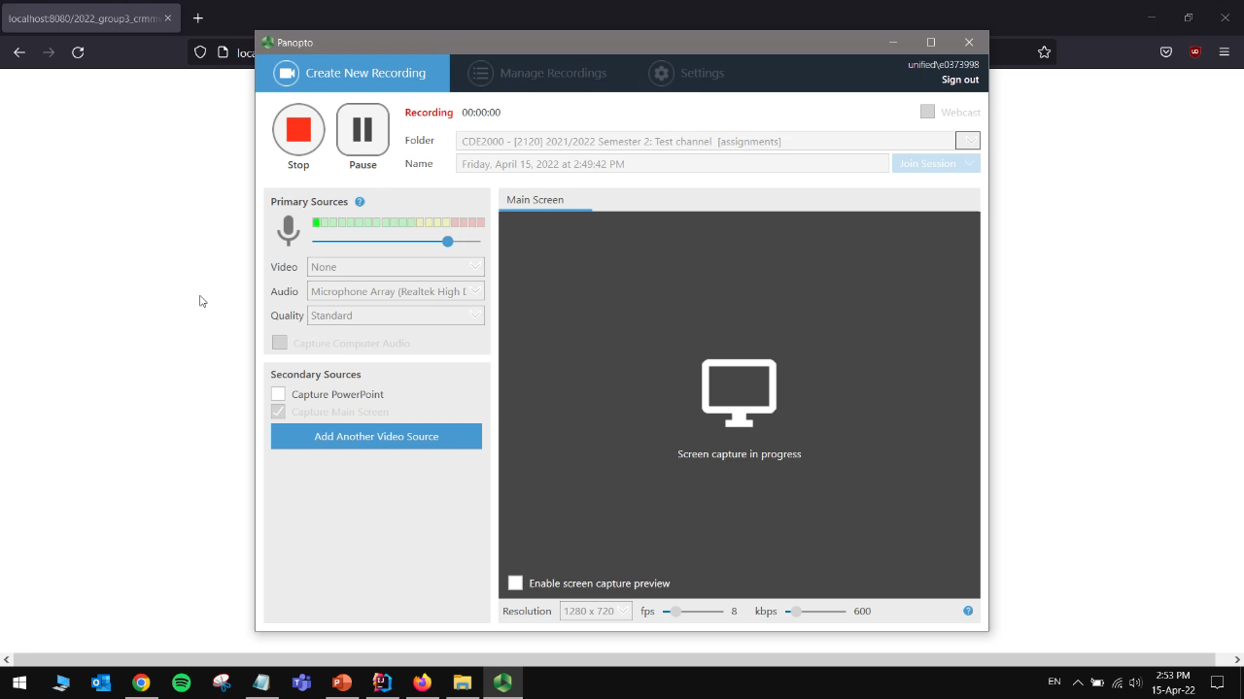
Application – Brief Demo

Slide 5







Application – Technology Stack
Apache Tomcat
MariaDB and MySQL
Java, Spring and MAVEN
Github Actions
Docker
Ubuntu

Slide 6
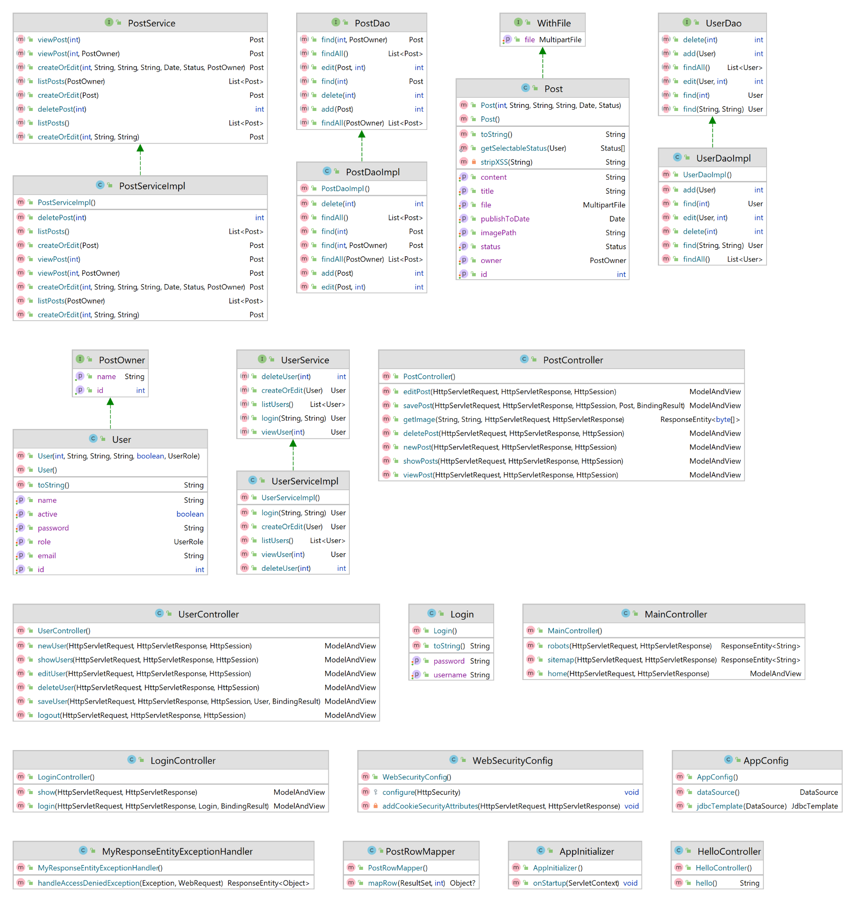
sg.lam.crmmvc package (1)

Slide 7
sg.lam.crmmvc package (2)

Slide 8
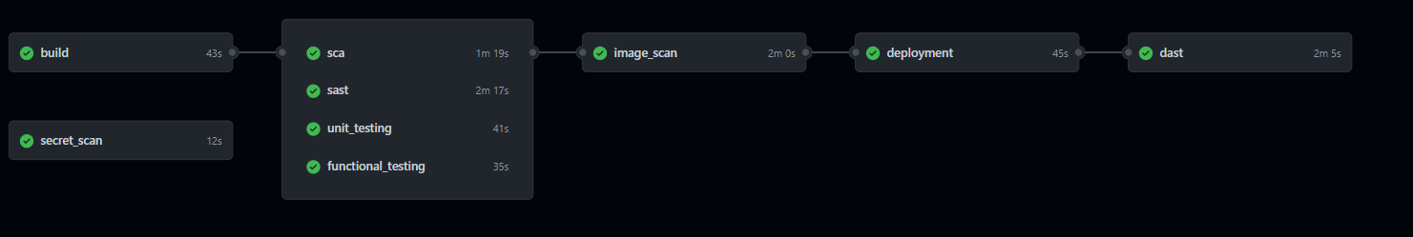
CI/CD Pipeline – Overview

Slide 9
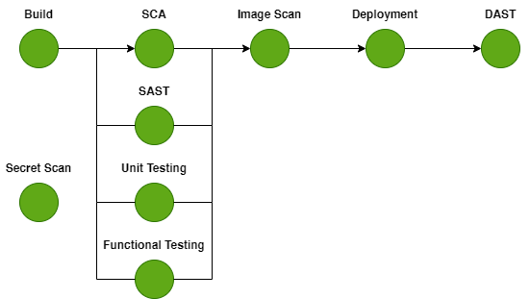
CI/CD Pipeline – Overview
Security Test | Tool Used
Secret Scan | Trufflehog
SCA | Microsoft App Inspector & Snyk
SAST | CodeQL & Snyk Code
Image Scan | Dockle
DAST | OWASP ZAP

Slide 10
Secret Scan (Trufflehog) – Output & Fix
S/N | Reason | File Path | Reason | Conclusion | Fix
1 | High Entropy | db/database.sql db/crmmvc.sql | Database dump files contain hashed passwords. | False Positive | Exclude file paths from secret scan: ^db/database.sql$ ^db/crmmvc.sql$
2 | High Entropy | src/main/webapp/edit_post.jsp src/main/webapp/edit_user.jsp src/main/webapp/hello.jsp src/main/webapp/index.jsp src/main/webapp/login.jsp src/main/webapp/posts.jsp src/main/webapp/users.jsp src/main/webapp/view_post.jsp | Bootstrap hash integrity values. | False Positive | Exclude path from secret scan. ^src/main/webapp/

Slide 11
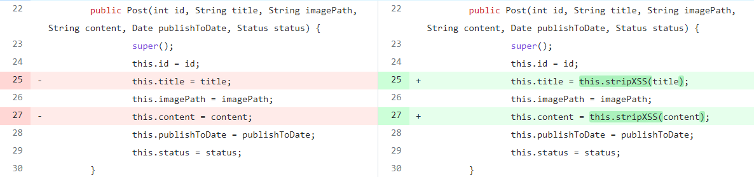
Unit Test – Output & Fix
S/N | Test Case | File Path | Root Cause | Conclusion | Fix
1 | testSanitizer | Post.java | When title and content properties are initialized in Post object by the constructor, stripXSS() sanitizer was not called. | Security Bug | Fix source code at constructor by calling stripXSS subroutine.
Yong Xian to add this part

Slide 12
SCA (Microsoft App Inspector & Snyk) – Output 1
S/N | Vulnerability | Severity Level | Fix | Details of Vulnerability
1 | Arbitrary Code Execution | Critical | Upgrade commons-fileupload:commons-fileupload@1.3.2 to commons-fileupload:commons-fileupload@1.3.3 to fix | https://snyk.io/vuln/SNYK-JAVA-COMMONSFILEUPLOAD-30401 in commons-fileupload:commons-fileupload@1.3.2
2 | Improper Input Validation | Medium | Upgrade org.hibernate.validator:hibernate-validator@6.0.11.Final to org.hibernate.validator:hibernate-validator@6.0.19.Final to fix | https://snyk.io/vuln/SNYK-JAVA-ORGHIBERNATEVALIDATOR-568163 in org.hibernate.validator:hibernate-validator@6.0.11.Final
3 | Cross-site Scripting (XSS) | Medium | Upgrade org.hibernate.validator:hibernate-validator@6.0.11.Final to org.hibernate.validator:hibernate-validator@6.0.19.Final to fix | https://snyk.io/vuln/SNYK-JAVA-ORGHIBERNATEVALIDATOR-541187 in org.hibernate.validator:hibernate-validator@6.0.11.Final
4 | Privilege Escalation | Medium | Upgrade org.springframework.security:spring-security-core@3.2.0.RELEASE to org.springframework.security:spring-security-core@5.2.9.RELEASE to fix | https://snyk.io/vuln/SNYK-JAVA-ORGSPRINGFRAMEWORKSECURITY-1078232 in org.springframework.security:spring-security-core@3.2.0.RELEASE
5 | Authentication Bypass | High | Upgrade org.springframework.security:spring-security-core@3.2.0.RELEASE to org.springframework.security:spring-security-core@5.2.9.RELEASE to fix | https://snyk.io/vuln/SNYK-JAVA-ORGSPRINGFRAMEWORKSECURITY-30175 in org.springframework.security:spring-security-core@3.2.0.RELEASE
6 | Improper Handling of Case Sensitivity (new) | Low | Upgrade org.springframework:spring-context@5.0.0.RELEASE to org.springframework:spring-context@5.3.17 to fix | https://snyk.io/vuln/SNYK-JAVA-ORGSPRINGFRAMEWORK-2689634 in org.springframework:spring-context@5.0.0.RELEASE
7 | Denial of Service (DoS) (new) | Medium | Upgrade org.springframework:spring-context@5.0.0.RELEASE to org.springframework:spring-context@5.3.17 to fix | https://snyk.io/vuln/SNYK-JAVA-ORGSPRINGFRAMEWORK-2434828 in org.springframework:spring-expression@5.0.0.RELEASE
8 | Improper Input Validation | Medium | Upgrade org.springframework:spring-context@5.0.0.RELEASE to org.springframework:spring-context@5.3.17 to fix | https://snyk.io/vuln/SNYK-JAVA-ORGSPRINGFRAMEWORK-2330878 in org.springframework:spring-core@5.0.0.RELEASE
9 | Improper Output Neutralization for Logs | Medium | Upgrade org.springframework:spring-context@5.0.0.RELEASE to org.springframework:spring-context@5.3.17 to fix | https://snyk.io/vuln/SNYK-JAVA-ORGSPRINGFRAMEWORK-2329097 in org.springframework:spring-core@5.0.0.RELEASE
10 | Multipart Content Pollution | Medium | Upgrade org.springframework:spring-context@5.0.0.RELEASE to org.springframework:spring-context@5.3.17 to fix | https://snyk.io/vuln/SNYK-JAVA-ORGSPRINGFRAMEWORK-460644 in org.springframework:spring-core@5.0.0.RELEASE
11 | Remote Code Execution (new) | Critical | Upgrade org.springframework:spring-context@5.0.0.RELEASE to org.springframework:spring-context@5.3.17 to fix | https://snyk.io/vuln/SNYK-JAVA-ORGSPRINGFRAMEWORK-2436751 in org.springframework:spring-beans@5.0.0.RELEASE
12 | Denial of Service (DoS) | Low | Upgrade org.springframework:spring-webmvc@5.0.0.RELEASE to org.springframework:spring-webmvc@5.2.15.RELEASE to fix | https://snyk.io/vuln/SNYK-JAVA-ORGSPRINGFRAMEWORK-72470 in org.springframework:spring-web@5.0.0.RELEASE
13 | Privilege Escalation | Medium | Upgrade org.springframework:spring-webmvc@5.0.0.RELEASE to org.springframework:spring-webmvc@5.2.15.RELEASE to fix | https://snyk.io/vuln/SNYK-JAVA-ORGSPRINGFRAMEWORK-1296829 in org.springframework:spring-web@5.0.0.RELEASE
14 | Information Exposure | Medium | Upgrade org.springframework:spring-webmvc@5.0.0.RELEASE to org.springframework:spring-webmvc@5.2.15.RELEASE to fix | https://snyk.io/vuln/SNYK-JAVA-ORGSPRINGFRAMEWORK-31689 in org.springframework:spring-web@5.0.0.RELEASE
15 | Cross-Site Tracing (XST) | Medium | Upgrade org.springframework:spring-webmvc@5.0.0.RELEASE to org.springframework:spring-webmvc@5.2.15.RELEASE to fix | https://snyk.io/vuln/SNYK-JAVA-ORGSPRINGFRAMEWORK-451604 in org.springframework:spring-web@5.0.0.RELEASE
16 | Information Exposure | Medium | Upgrade org.springframework:spring-webmvc@5.0.0.RELEASE to org.springframework:spring-webmvc@5.2.15.RELEASE to fix | https://snyk.io/vuln/SNYK-JAVA-ORGSPRINGFRAMEWORK-467268 in org.springframework:spring-webmvc@5.0.0.RELEASE

Slide 13
SCA (Microsoft App Inspector & Snyk) – Output 2
S/N | Vulnerability | Severity Level | Fix | Details of Vulnerability
17 | Multipart Content Pollution | Medium | Upgrade org.springframework:spring-webmvc@5.0.0.RELEASE to org.springframework:spring-webmvc@5.2.15.RELEASE to fix | https://snyk.io/vuln/SNYK-JAVA-ORGSPRINGFRAMEWORK-32199 in org.springframework:spring-webmvc@5.0.0.RELEASE
18 | Directory Traversal | Medium | Upgrade org.springframework:spring-webmvc@5.0.0.RELEASE to org.springframework:spring-webmvc@5.2.15.RELEASE to fix | https://snyk.io/vuln/SNYK-JAVA-ORGSPRINGFRAMEWORK-32202 in org.springframework:spring-webmvc@5.0.0.RELEASE
19 | Improper Input Validation | High | Upgrade org.springframework:spring-webmvc@5.0.0.RELEASE to org.springframework:spring-webmvc@5.2.15.RELEASE to fix | https://snyk.io/vuln/SNYK-JAVA-ORGSPRINGFRAMEWORK-1009832 in org.springframework:spring-web@5.0.0.RELEASE
20 | Reflected File Download (RFD) | High | Upgrade org.springframework:spring-webmvc@5.0.0.RELEASE to org.springframework:spring-webmvc@5.2.15.RELEASE to fix | https://snyk.io/vuln/SNYK-JAVA-ORGSPRINGFRAMEWORK-559346 in org.springframework:spring-web@5.0.0.RELEASE
21 | Cross-site Scripting (XSS) | Medium | Upgrade org.webjars:bootstrap@3.0.0 to org.webjars:bootstrap@3.4.1 to fix | https://snyk.io/vuln/SNYK-JAVA-ORGWEBJARS-451160 in org.webjars:bootstrap@3.0.0
22 | Cross-site Scripting (XSS) | Medium | Upgrade org.webjars:bootstrap@3.0.0 to org.webjars:bootstrap@3.4.1 to fix | https://snyk.io/vuln/SNYK-JAVA-ORGWEBJARS-451162 in org.webjars:bootstrap@3.0.0
23 | Cross-site Scripting (XSS) | Medium | Upgrade org.webjars:bootstrap@3.0.0 to org.webjars:bootstrap@3.4.1 to fix | https://snyk.io/vuln/SNYK-JAVA-ORGWEBJARS-451164 in org.webjars:bootstrap@3.0.0
24 | Cross-site Scripting (XSS) | Medium | Upgrade org.webjars:bootstrap@3.0.0 to org.webjars:bootstrap@3.4.1 to fix | https://snyk.io/vuln/SNYK-JAVA-ORGWEBJARS-451168 in org.webjars:bootstrap@3.0.0
25 | Cross-site Scripting (XSS) | Medium | Upgrade org.webjars:bootstrap@3.0.0 to org.webjars:bootstrap@3.4.1 to fix | https://snyk.io/vuln/SNYK-JAVA-ORGWEBJARS-479505 in org.webjars:bootstrap@3.0.0
26 | Cross-site Scripting (XSS) | Medium | Upgrade org.webjars:jquery@1.9.1 to org.webjars:jquery@3.5.0 to fix | https://snyk.io/vuln/SNYK-JAVA-ORGWEBJARS-565171 in org.webjars:jquery@1.9.1
27 | Cross-site Scripting (XSS) | Medium | Upgrade org.webjars:jquery@1.9.1 to org.webjars:jquery@3.5.0 to fix | https://snyk.io/vuln/SNYK-JAVA-ORGWEBJARS-567882 in org.webjars:jquery@1.9.1
28 | Prototype Pollution | Medium | Upgrade org.webjars:jquery@1.9.1 to org.webjars:jquery@3.5.0 to fix | https://snyk.io/vuln/SNYK-JAVA-ORGWEBJARS-479774 in org.webjars:jquery@1.9.1
29 | Cross-site Scripting (XSS) | Medium | Upgrade org.webjars:jquery@1.9.1 to org.webjars:jquery@3.5.0 to fix | https://snyk.io/vuln/SNYK-JAVA-ORGWEBJARS-479782 in org.webjars:jquery@1.9.1
30 | Denial of Service (DoS) | High | Issues with no direct upgrade or patch | https://snyk.io/vuln/SNYK-JAVA-COMGOOGLEPROTOBUF-2331703 in com.google.protobuf:protobuf-java@3.11.4
31 | Directory Traversal | Medium | Issues with no direct upgrade or patch | https://snyk.io/vuln/SNYK-JAVA-COMMONSIO-1277109 in commons-io:commons-io@2.2
32 | XML External Entity (XXE) Injection | High | Issues with no direct upgrade or patch | https://snyk.io/vuln/SNYK-JAVA-JAVAXSERVLET-30449 in javax.servlet:jstl@1.2

Slide 14
SCA (Microsoft App Inspector & Snyk) – Fix
S/N | Vulnerable Package Name | Vulnerability | Severity Level | Rationale for not fixing
1 | in com.google.protobuf:protobuf-java@3.11.4, introduced by mysql:mysql-connector-java@8.0.28 > com.google.protobuf:protobuf-java@3.11.4 | Denial of Service (DoS) | High | Issues with no direct upgrade or patch
2 | in commons-io:commons-io@2.2, introduced by commons-fileupload:commons-fileupload@1.3.3 > commons-io:commons-io@2.2 | Directory Traversal | Medium | Issues with no direct upgrade or patch
3 | in javax.servlet:jstl@1.2, introduced by javax.servlet:jstl@1.2. No upgrade or patch available | XML External Entity (XXE) Injection | High | Issues with no direct upgrade or patch. Suggest to disable XEE.

Slide 15
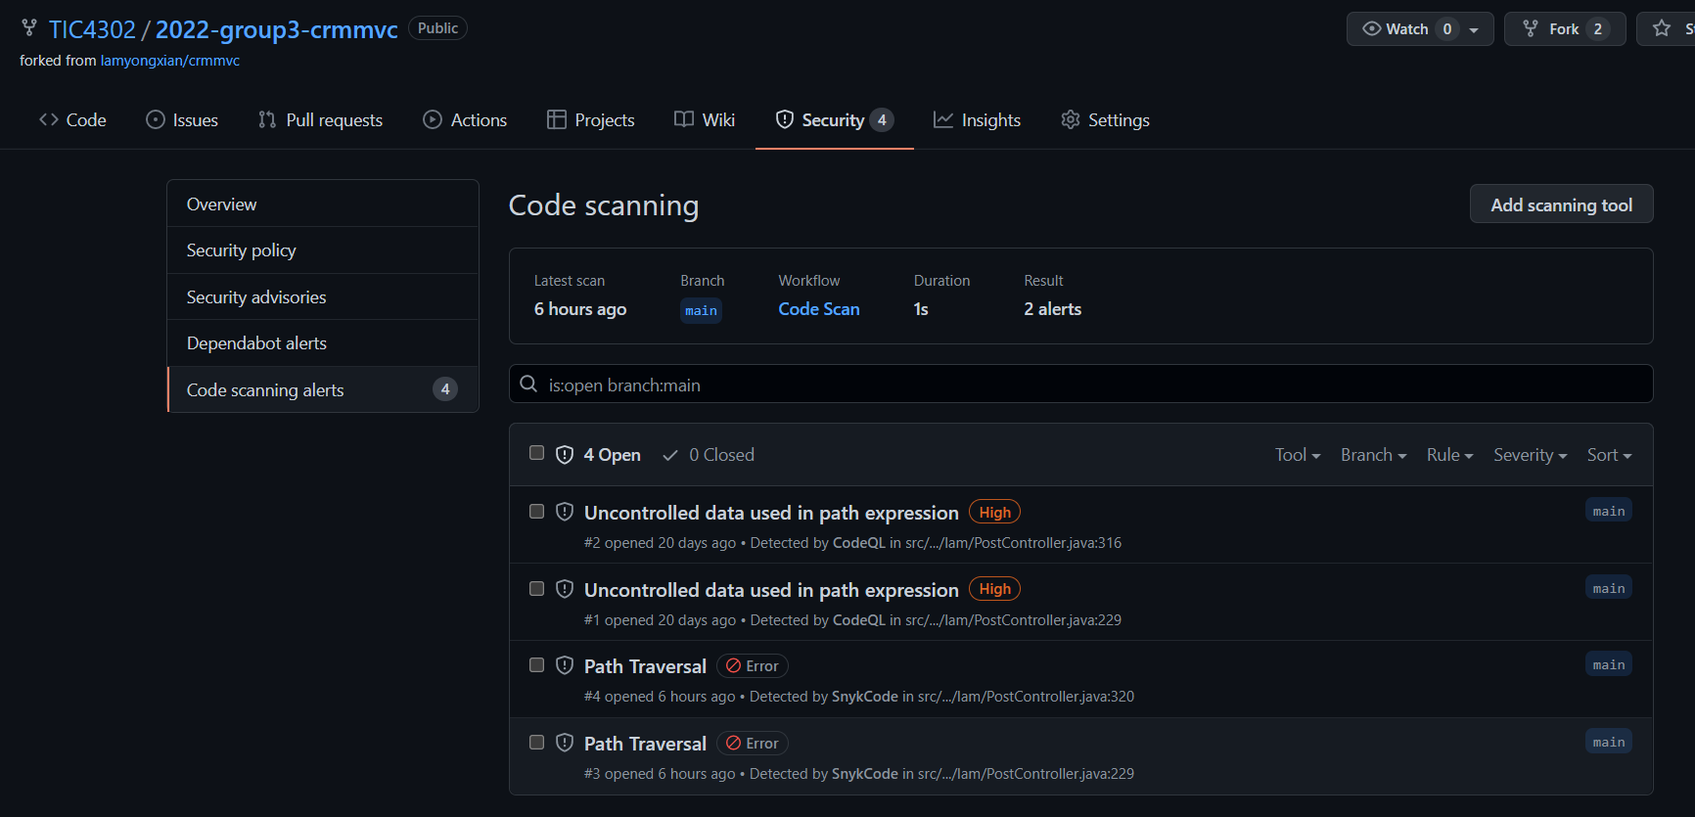
SAST (CodeQL & Snyk) – Output 1
①
②
③

Slide 16
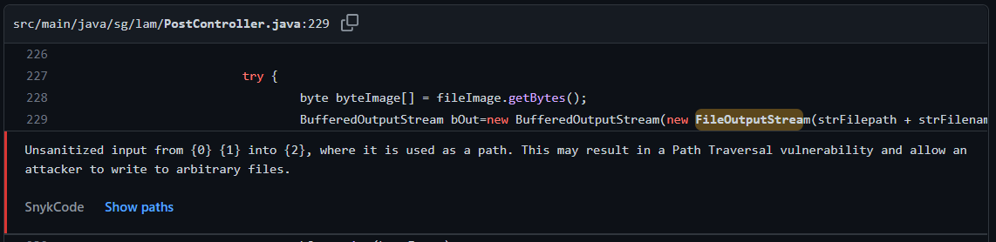
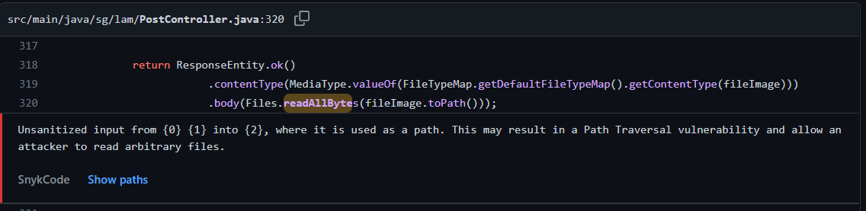
SAST (CodeQL & Snyk Code) – Output 2
Vulnerability | Description | Risk | Implication
CWE-35: Path Traversal | src/main/java/sg/lam/PostController.java:229 src/main/java/sg/lam/PostController.java:320 | High High | Directory Traversal attack (also known as path traversal) aims to access files and directories that are stored outside the intended folder. By manipulating files with "dot-dot-slash (../)" sequences and its variations, or by using absolute file paths, it may be possible to access arbitrary files and directories stored on file system, including application source code, configuration, and other critical system files.

Slide 17
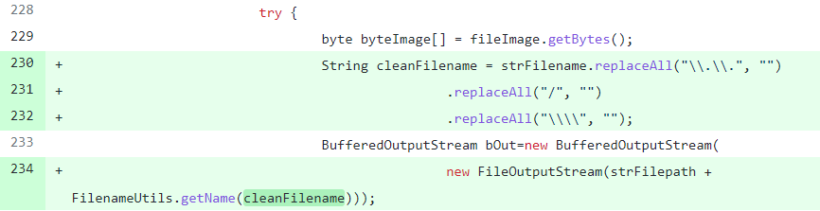
SAST (CodeQL & Snyk Code) – Fix
Vulnerability | After applying fix
CWE-35: Path Traversal | src/main/java/sg/lam/PostController.java:229 Filename taken from user input is explicitly sanitized by removing all “/”, “\” and “..” using RegEx (Line 230-232). The sanitized filename is then passed into FilenameUtils.get() to remove all paths before appending to the FileOutStream() as argument (Line 234).

Slide 18
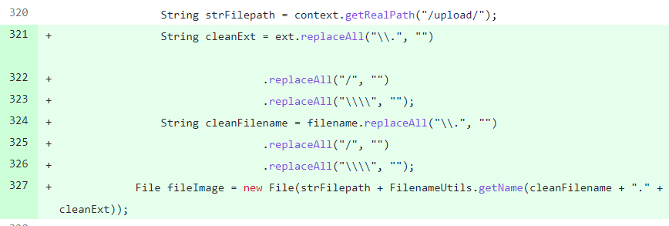
SAST (CodeQL & Snyk Code) – Fix
Vulnerability | After applying fix
CWE-35: Path Traversal | src/main/java/sg/lam/PostController.java:320 Filename and File extension taken from user input are explicitly sanitized by removing all “/”, “\” and “.” using RegEx (Line 321-326). The sanitized filename and file extension are then passed into FilenameUtils.get() to remove all paths before appending to the File() constructor as argument (Line 327).

Slide 19
Image scan (Dockle) – Output & Fix
S/N | Vulnerability | Rating | Fix
1 | CIS-DI-0009: Use COPY instead of ADD in Dockerfile | Fatal | Change ADD to COPY
2 | CIS-DI-0001: Create a user for the container | Warn | Not Applicable as rating is Warning
3 | DKL-DI-0006: Avoid latest tag | Warn | Not Applicable as rating is Warning
4 | CIS-DI-0005: Enable Content trust for Docker | Info | Not Applicable as rating is Info
5 | CIS-DI-0006: Add HEALTHCHECK instruction to the container image | Info | Not Applicable as rating is Info
6 | CIS-DI-0008: Confirm safety of setuid/setgid files | Info | Not Applicable as rating is Info

Slide 20
DAST (OWASP ZAP) – Output 1
S/N | Vulnerability | Affected Page
1 | WARN-NEW: Cross-Domain JavaScript Source File Inclusion [10017] x 2 | http://app:8080/CRMMVC/login (200 OK) http://app:8080/CRMMVC/login2 (200 OK)
2 | WARN-NEW: Missing Anti-clickjacking Header [10020] x 4 | http://app:8080/ (200 OK) http://app:8080/CRMMVC/ (200 OK) http://app:8080/CRMMVC/login (200 OK) http://app:8080/CRMMVC/login2 (200 OK)
3 | WARN-NEW: X-Content-Type-Options Header Missing [10021] x 5 | http://app:8080/ (200 OK) http://app:8080/CRMMVC/ (200 OK) http://app:8080/CRMMVC/login (200 OK) http://app:8080/CRMMVC/resources/crm.png (200 OK) http://app:8080/CRMMVC/login2 (200 OK)
4 | WARN-NEW: User Controllable HTML Element Attribute (Potential XSS) [10031] x 2 | http://app:8080/CRMMVC/login2 (200 OK) http://app:8080/CRMMVC/login2 (200 OK)

Slide 21
DAST (OWASP ZAP) – Output 2
S/N | Vulnerability | Affected Page
5 | WARN-NEW: Content Security Policy (CSP) Header Not Set [10038] x 6 | http://app:8080/ (200 OK) http://app:8080/CRMMVC/ (200 OK) http://app:8080/CRMMVC/login (200 OK) http://app:8080/robots.txt (404 Not Found) http://app:8080/sitemap.xml (404 Not Found)
6 | WARN-NEW: Cookie without SameSite Attribute [10054] x 4 | http://app:8080/ (200 OK) http://app:8080/CRMMVC/ (200 OK) http://app:8080/CRMMVC/login (200 OK) http://app:8080/CRMMVC/login2 (200 OK)
7 | WARN-NEW: Modern Web Application [10109] x 2 | http://app:8080/CRMMVC/login (200 OK) http://app:8080/CRMMVC/login2 (200 OK)
8 | WARN-NEW: Absence of Anti-CSRF Tokens [10202] x 2 | http://app:8080/CRMMVC/login (200 OK) http://app:8080/CRMMVC/login2 (200 OK)
9 | WARN-NEW: Loosely Scoped Cookie [90033] x 5 | http://app:8080/ (200 OK) http://app:8080/ (302 Found) http://app:8080/CRMMVC/ (200 OK) http://app:8080/CRMMVC/login (200 OK) http://app:8080/CRMMVC/login2 (200 OK)

Slide 22
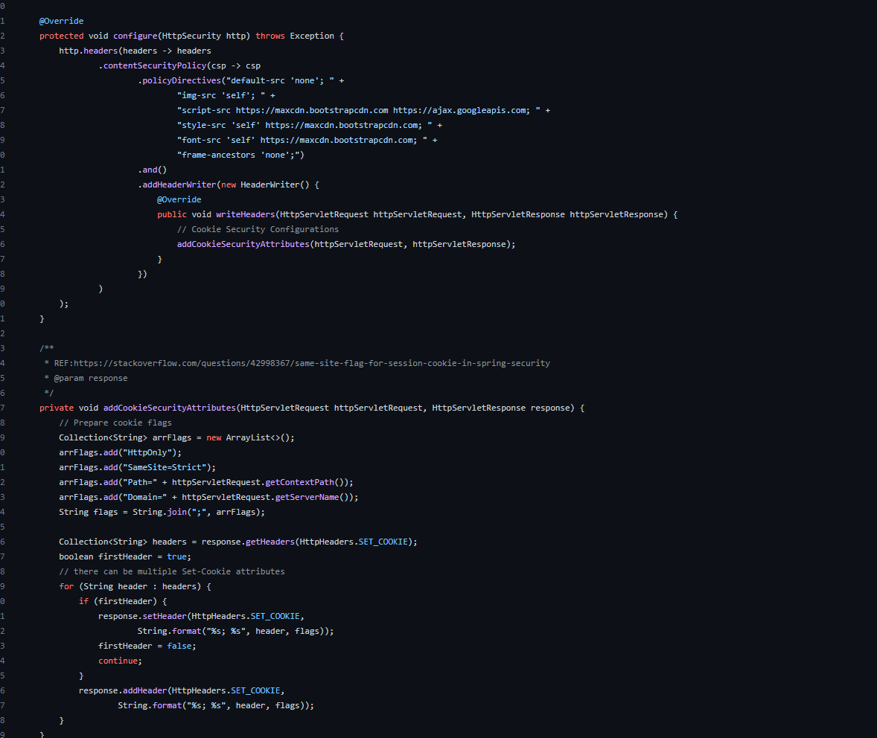
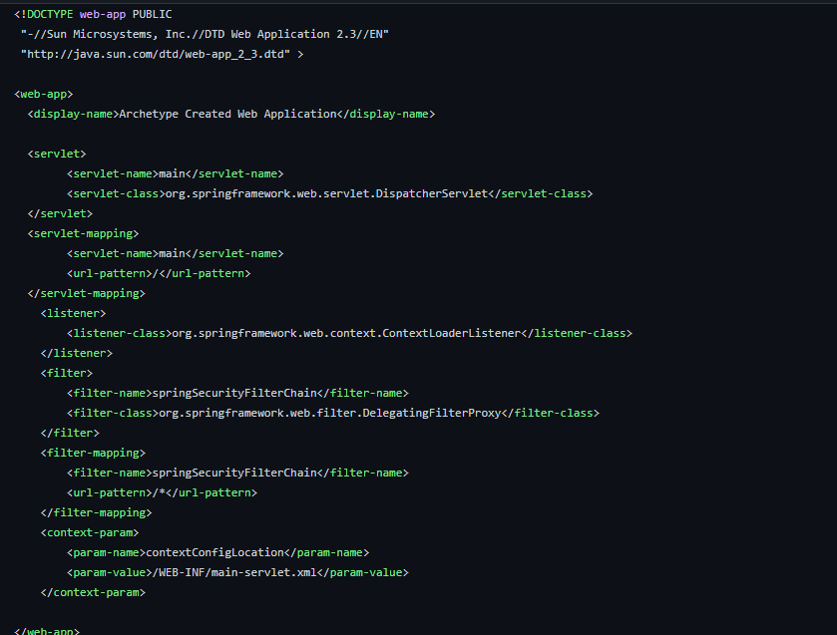
WebSecurityConfig.java class & web.xml file to address issues highlighted by owasp zap scan

Slide 23
DAST (OWASP ZAP) – Fix
S/N | Vulnerability | Fix
1 | WARN-NEW: Cross-Domain JavaScript Source File Inclusion [10017] x 2 | Added Content-Security-Policy ‘script-src’
2 | WARN-NEW: Missing Anti-clickjacking Header [10020] x 4 | Added Content-Security-Policy ‘frame-ancestors’
3 | WARN-NEW: X-Content-Type-Options Header Missing [10021] x 5 | Enabled X-Content-Type-Options in Spring Security
5 | WARN-NEW: Content Security Policy (CSP) Header Not Set [10038] x 6 | Added Content-Security-Policy ‘default-src’ on pages.
6 | WARN-NEW: Cookie without SameSite Attribute [10054] x 4 | Added SameSite Cookie flag
8 | WARN-NEW: Absence of Anti-CSRF Tokens [10202] x 2 | Enabled Anti-CSRF Tokens in Spring Security
9 | WARN-NEW: Loosely Scoped Cookie [90033] x 5 | Added Domain and Path scope to all session cookies

Slide 24
DAST (OWASP ZAP) – Not Fixed and Acceptance
S/N | Vulnerability | Affected Page | Rationale
4 | WARN-NEW: User Controllable HTML Element Attribute (Potential XSS) [10031] x 2 | http://app:8080/CRMMVC/login2 (200 OK) http://app:8080/CRMMVC/login2 (200 OK) | False positive from code review.
7 | WARN-NEW: Modern Web Application [10109] x 2 | http://app:8080/CRMMVC/login (200 OK) http://app:8080/CRMMVC/login2 (200 OK) | False positive
9 | WARN-NEW: Loosely Scoped Cookie [90033] x 5 | http://app:8080/ (200 OK) http://app:8080/CRMMVC/ (200 OK) | False positive. Non-cookie pages.
10* | WARN-NEW: CSP: Wildcard Directive [10055] x 4 | http://app:8080/ (200 OK) http://app:8080/CRMMVC/ (200 OK) http://app:8080/CRMMVC/login (200 OK) http://app:8080/CRMMVC/login2 (200 OK) | False positive. *New item.

Slide 25
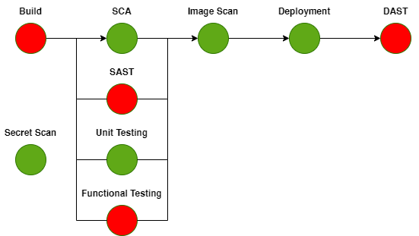
Problem faced (Broken pipeline)
Node | Problem faced
Build | Challenges with legacy Spring Framework and Dependencies
SAST | Finding the right SAST for Java / Spring MVC
Functional Test | Legacy database dump, syntax and collation issue
DAST | Error code 404, unable to find sub-directory
×
×
×
×

Slide 26


Build Process
With a Java webapp, we had to figure out how we could run the WAR file in tomcat, we had to figure out which ports, how exactly do we run the webapp and translating it to a docker compose and dockerfile output. Take away from this process was /resources/application.properties has to tally with db.env and docker-compose.yml e.g jdbc.url=jdbc:mysql://db:3306/crmmvc must follow docker-compose.yml services name for db. This connection string issue is very much different from a python web app example given.
Dependencies in Spring Framework is defined through the Maven pom.xml file, during upgrade the individual dependencies cause compile errors due to incompatibility which impact our functional test

Slide 27





SAST Process
SAST options available were outdated and some do not fit our CI/CD environment. We had to further explore to find option that fit our CI/CD environment.
CodeQL gave us an information overload however the required information can be found in the security tab of Github. Eventually provides us a second opinion for false positivity
Decided on using Snyk Code (Free) which is the best option, however it has limited runs for free account
LGTM
CodeQL
FindBugs
Graudit

Slide 28


Functional Test Process
Main problem faced was performing the login test. Grappled with the issue of how the application does a successful connection to the database.
Error 500: Internal server error was presented, there was two issue faced, firstly the database.sql from MySQL 5.6 was not dumped correctly thus the database was not created due to syntax ordering and collation. App unable to login to database but fail silently.
Connection error: Error was ambiguous, it was related to dockerfile and docker-compose.yml settings. The docker network and services name need to be correct defined.

Slide 29

DAST Process
Main issue revolved surrounding using Docker-based ZAP scanning another docker container. We corrected the docker network specified with --net argument.
Trial and error with using localhost:8080, 127.0.0.1:8080 and app:8080 to access Tomcat web server.
ZAP has a limitation with root path / and the workaround was found using Tomcat jsp redirection as we kept seeing error 404 initially.

Slide 30
Endstate of CI/CD Pipeline
✓
✓
✓
✓
✓
✓
✓
✓
✓

Slide 31
Thank You!

